Slide 1
Educational Attainment and Housing Affordability
Nejma Ahmed, Karisa Johnson, Ilhaan Omar, & Emma Stefanovich

Slide 2
Data: Zillow Home Values and IPUMS NHGIS
Data range: 2016-2020
Data focused on 19 zip codes in Ramsey County, MN
Zillow: Average home values per zip code (no rental housing)
IPUMS NHGIS:
Educational attainment level averages per zip code
Less than high school, high school, some college, bachelor’s or higher
Each level broken down by labor force participation

Slide 3
2016-2020 Housing Values and Education
Average home value statistics for all zip codes:
Mean average: $255,604
Lowest average: $181,401
Highest average: $377,193
Labor force statistics for all zip codes:
Bachelor’s degree or higher: 47.91%
Some college: 26.12%
High school diploma: 17.6%
Less than high school education: 8.37%

Slide 4
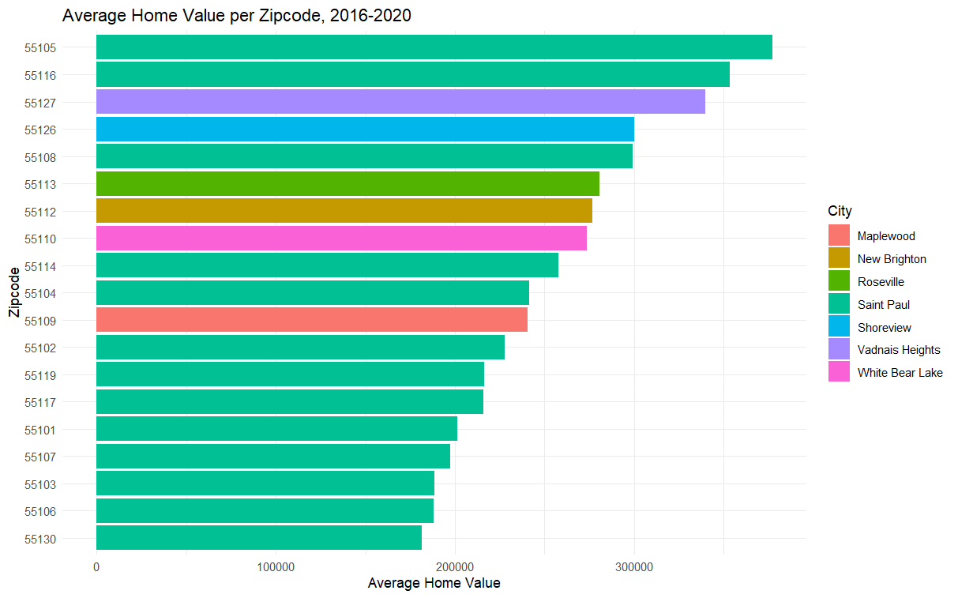

Slide 5
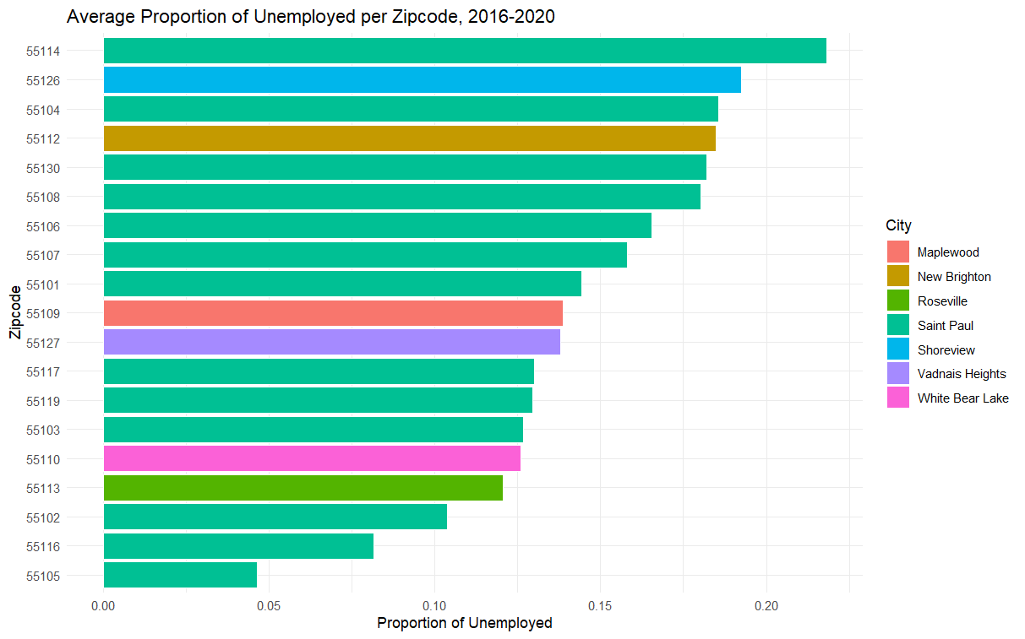

Slide 6
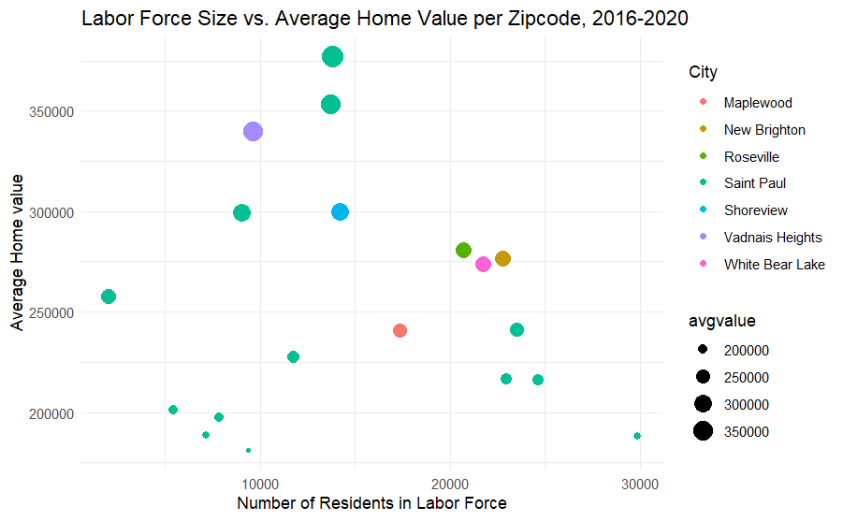

Slide 7
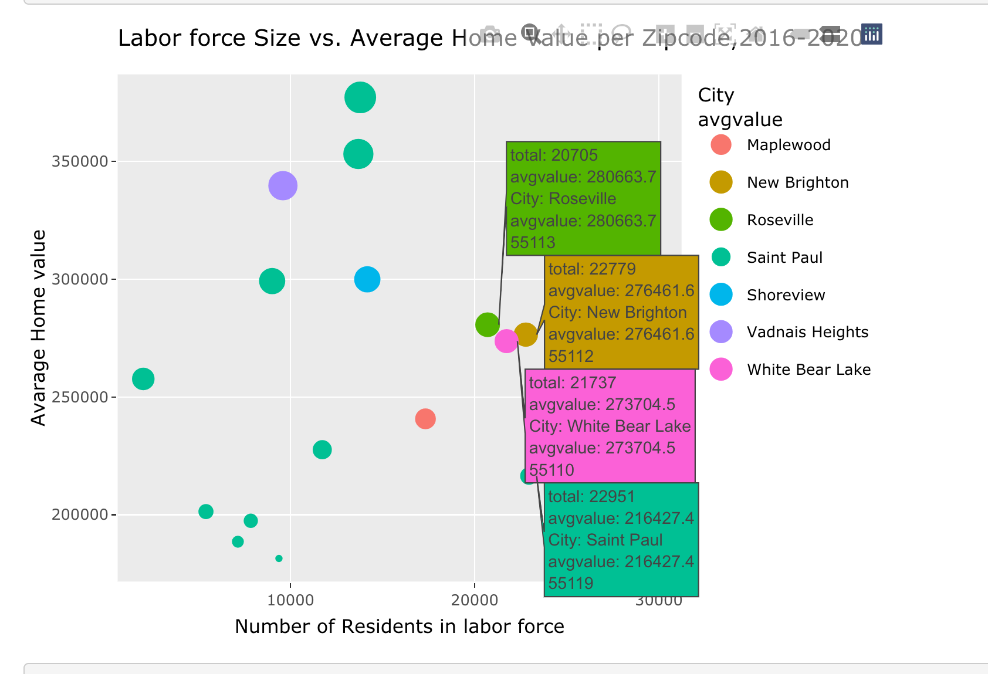

Slide 8
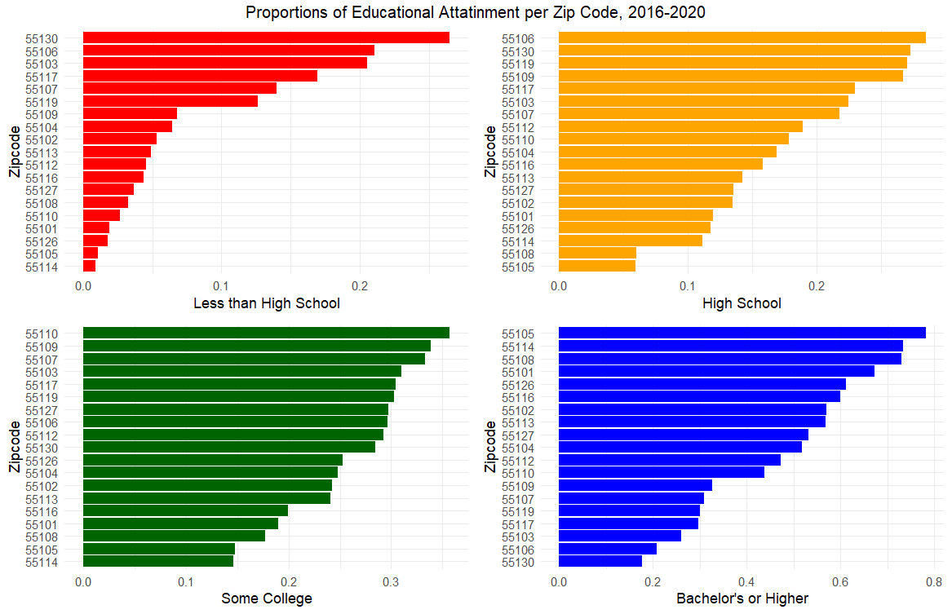

Slide 9
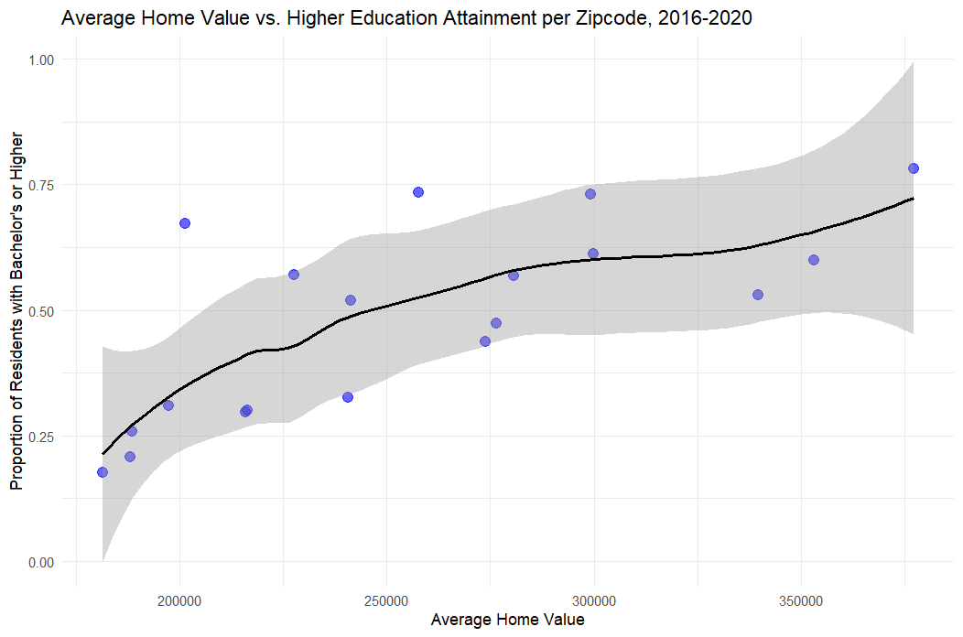

Slide 10
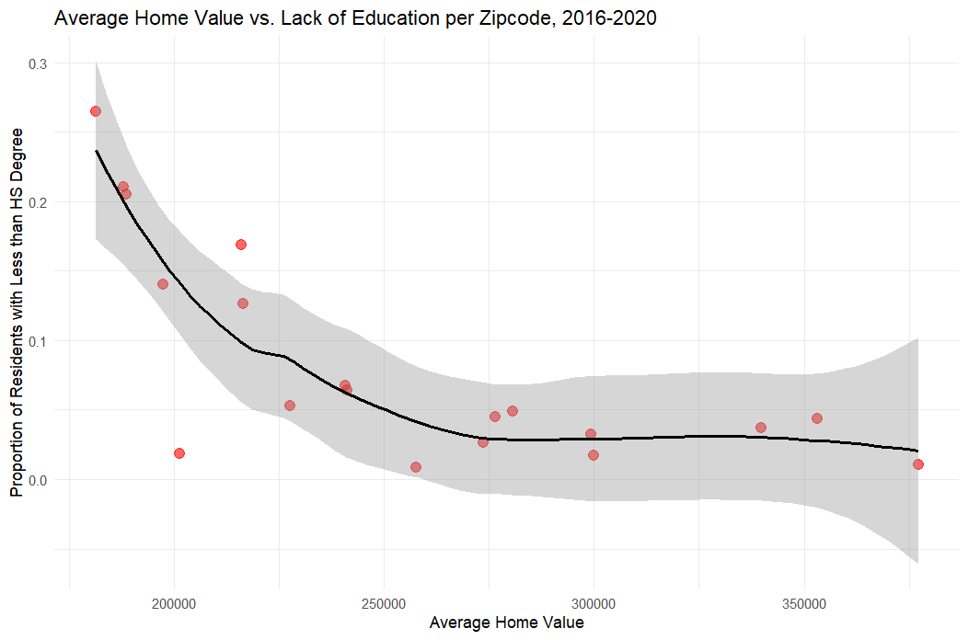

Slide 11
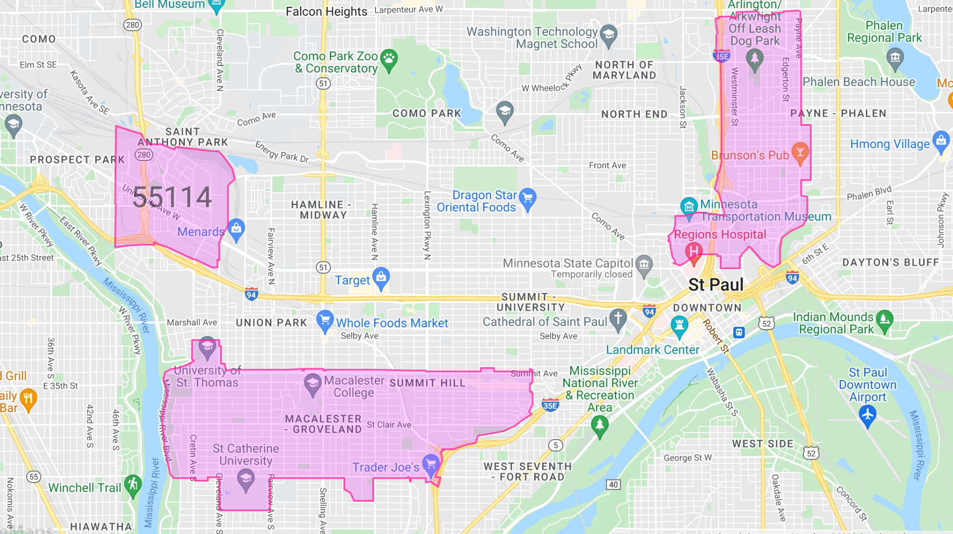
Conclusion
55130: Zip code with the highest proportion of low-educated workers and the lowest home values.
55105: Zip code with the highest proportion of educated workers, lowest proportion of unemployed, and the highest home values.
55114: Zip code with the highest proportion of unemployed labor force.
55130
55105

